Slide 1
Registration

Slide 2
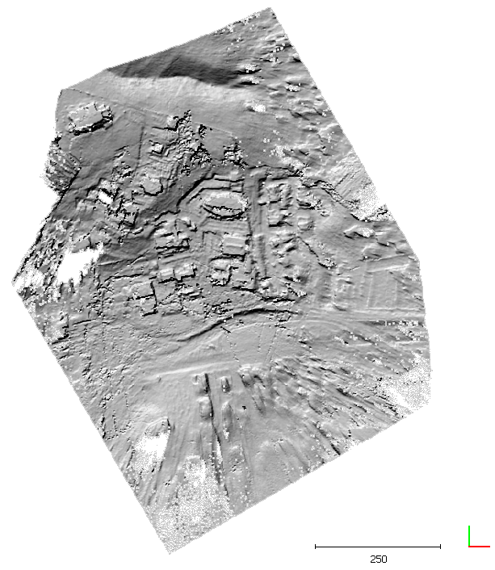
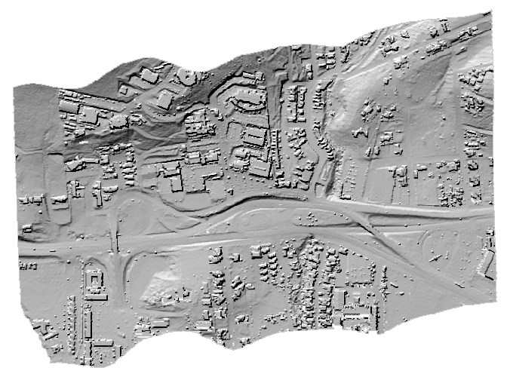
Load two clouds
Lidar_ensenada.laz
GoPro_ensenada.laz

Slide 3
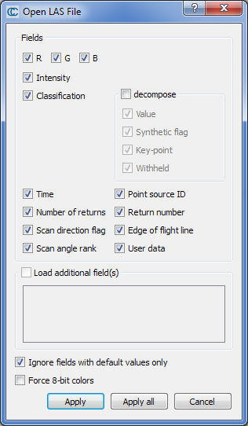
Loading a LAS/LAZ file
LAZ = compressed LAS
Standad LAS fields
  All fields can be loaded as scalar fields (but the RGB colors)
Keep the default options
Click on « Apply all »

Slide 4
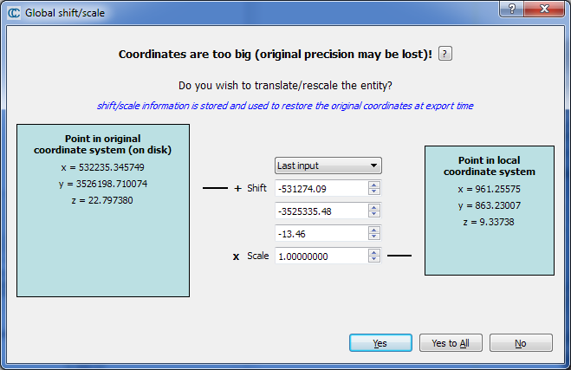
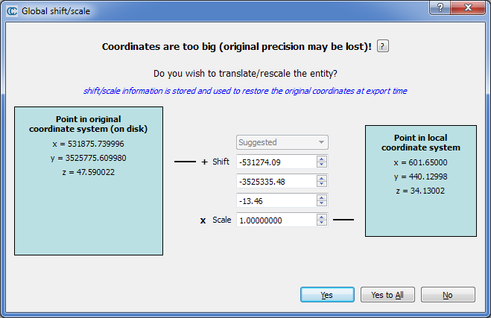
Loading a LAS/LAZ file
Large coordinates management
Be sure to use the same local coordinate system for both clouds!
CC and OpenGL don’t handle large numbers (> 10⁵)
  → Work in a local coordinate system (click on « Yes »)
  → Original coordinates will be restored at export time

Slide 5
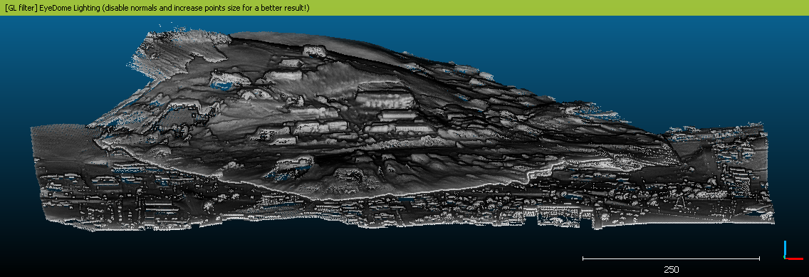
Shifted clouds
Options to align the clouds:
  Interactive transformation (inaccurate, painfull)
  Point-pair based alignment
  Automatic registration (ICP) → the two clouds must already be roughly aligned

Slide 6
Point-pair based alignment
Highlight two clouds and start the tool
( Tools > Registration > Align (point pair picking) )
Choose the LIDAR cloud as reference
Select (left click) 4 or 5 points on the top cloud (GoPro)
  Pick uniquely identifiable points
  Sample them all over the cloud (if possible)
  → Zoom in for a more accurate selection
Hide the ‘to align’ cloud ( ) and select the same points on the other cloud

Slide 7
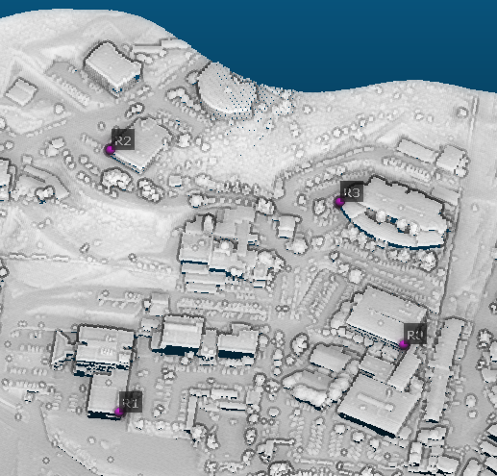
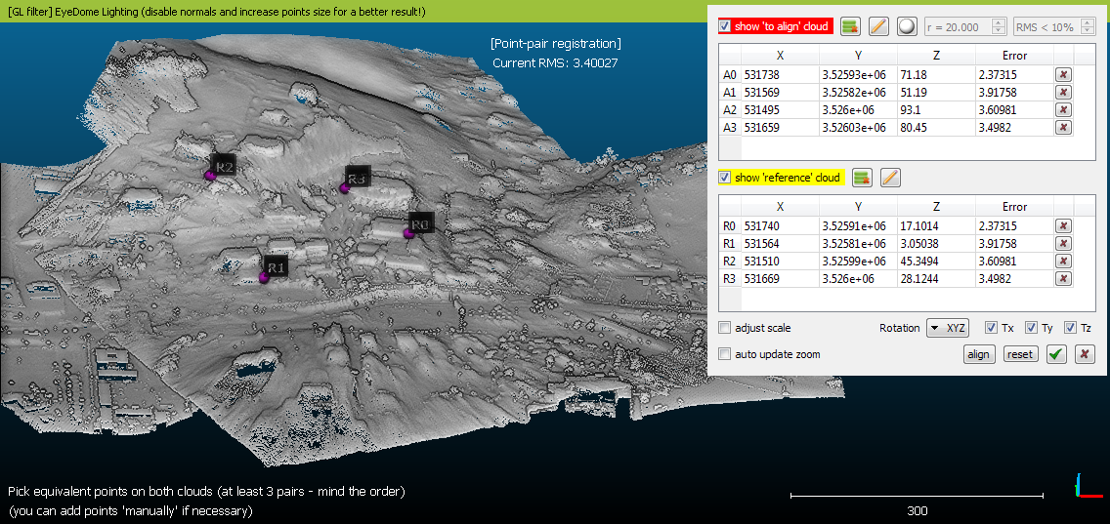
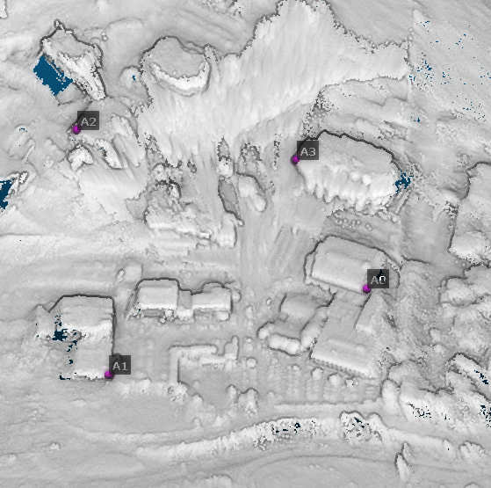
Point-pair based alignment
Click on « Align » to preview the result
Check the error contribution of each pair (you can add more pairs and / or remove some if necessary)
Notes:
  Option to rescale the aligned cloud
  Reference points (GCPs) can be input manually (no need to use a reference cloud)
Lidar
GoPro

Slide 8
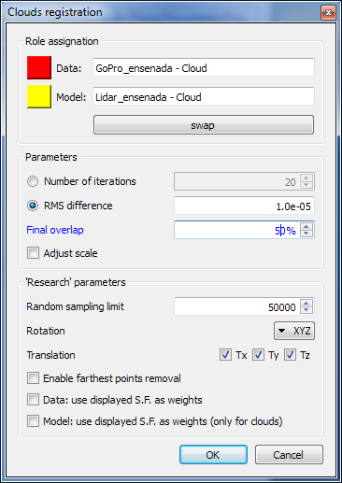
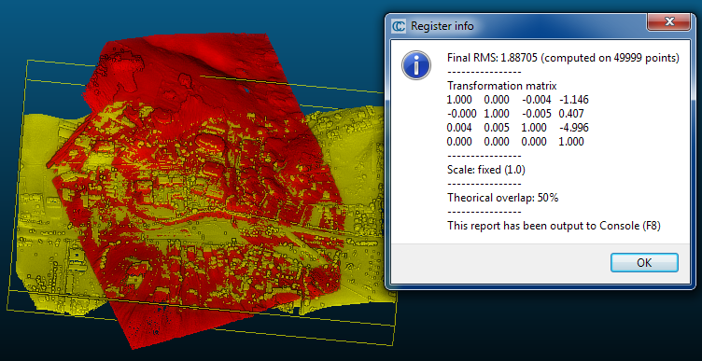
Automatic registration (ICP)
Highlight two clouds and start the tool
( Tools > Registration > Fine registration (ICP) )
Choose the LIDAR cloud as referene (use the « swap » button)
Select an "overlap" of 50%

Slide 9
Alignment tips
If entities have "structural" differences
  Small or medium local differences :
    ICP (+ option ‘Enable farthest points removal’ or use a small ‘Overlap’)
  Different scales:
    option ‘adjust scale’ (both tools)
  Major differences:
    Prefer the point pair based alignment
  Pay attention to holes / missing data!

Slide 10
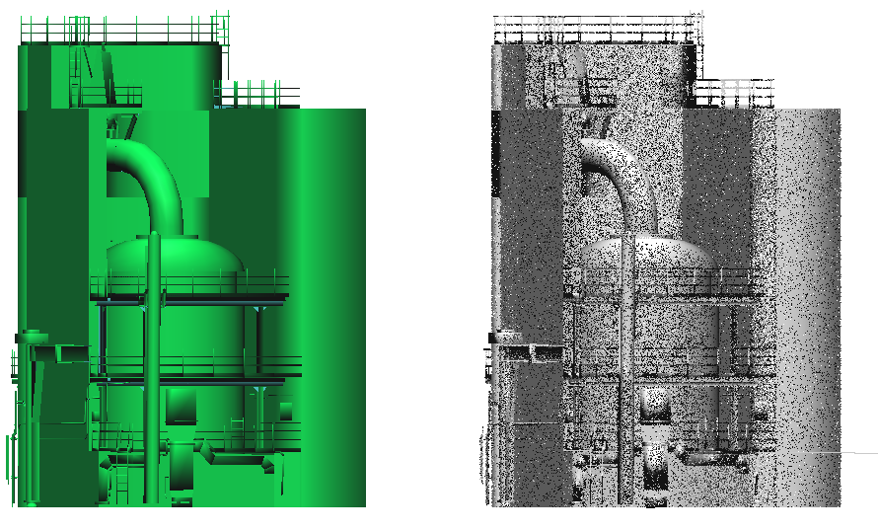
Alignment tips
If one entity is a mesh
  Almost the same process
  It can be useful to
    Sample a lot of points on the Mesh (Edit > Mesh > Sample points) and use it in place of the mesh
    Then apply the resulting transformation matrix to the original mesh (Edit > Apply Transformation)
  For fine registration (ICP), the mesh should always be the reference entity (the one that doesn’t move).
  → it’s generally less noisier and don’t have holes

